Slide 1

Federal Reserve Challenge NY 2017
Lindsey Metz
Austin McDonnell
Charles Manzari
Gordon Oxley

Slide 2
Today’s Agenda
Current Economic and Financial Conditions
Potential Headwinds and Tailwinds
Forecast
Policy Recommendation

Slide 3
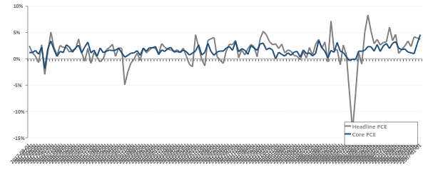
Inflation: PCE
Both Headline and Core PCE price indices’ annualized rates of growth have averaged 1.6% over past 10 years
August Core PCE, which excludes volatile food and energy prices, came in at 1.2%, 80bps below Fed’s 2% target
However, the Fed has succeeded in achieving stable prices over the past 10 years, with core inflation volatility at 0.8%, below 30 year average of 1.36%
Headline vs Core PCE
Annualized Rate (%)
Source: U.S. Bureau of Economic Analysis

Slide 4
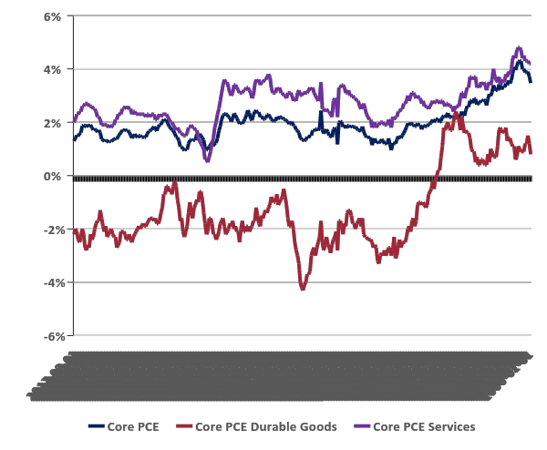
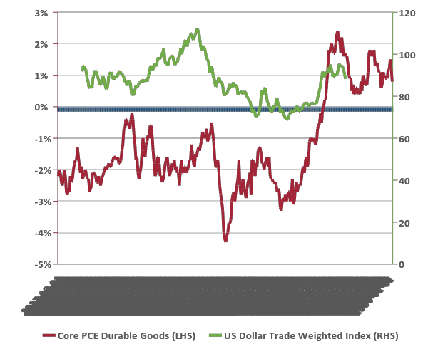
Inflation: Services vs Goods
By breaking PCE into goods and services components can understand inflation trends better
Core Services inflation has averaged 2.2% over past 10 years and has tracked Core PCE movements closely (Correlation: 0.84) since August of 2007
Core Durable Goods have been deflationary since Oct. 1995
Value of US Dollar and Durable Goods prices have negative correlation (-0.51 over past 10 Years); recent depreciation of dollar has resulted in uptick of prices
Core PCE Inflation and Its Components
12-month % change
Core PCE Goods vs. US Dollar
12-month % change | Index Mar 1973 = 100
Source: U.S. Bureau of Economic Analysis
Sources: U.S. Bureau of Economic Analysis; Board of Governors of the Federal Reserve System

Slide 5
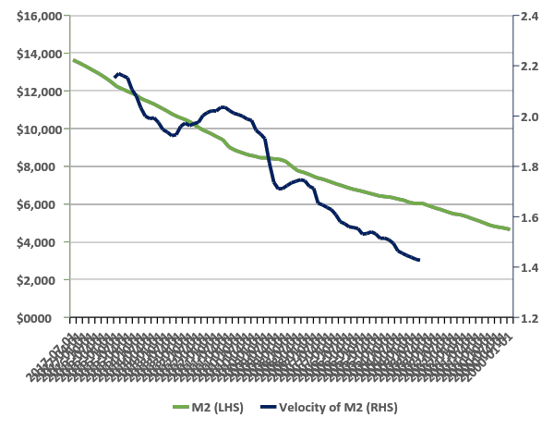
Money Supply
Large-scale asset purchases following Great Recession resulted in unprecedented expansion of monetary base. However, sharp decline in velocity of M2 has offset M2 expansion, coinciding with little change to 1%-2% GDP growth environment.
This may be a result of low rate environment eliminating opportunity cost of holding cash
As increasing consumer confidence materializes in increased spending, lending levels remains strong, and Fed tapering removes excess liquidity, we believe velocity of M2 will pick up resulting in higher growth and inflation
M2 vs Velocity of M2
USD Billions | Ratio
Sources: Federal Reserve Bank of St. Louis; Board of Governors of the Federal Reserve System

Slide 6
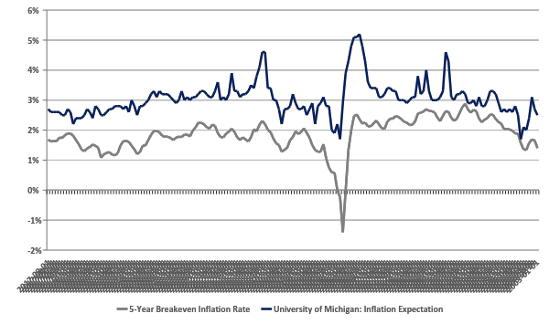
Inflation Expectations
Sources: Federal Reserve Bank of St. Louis; University of Michigan

Slide 7
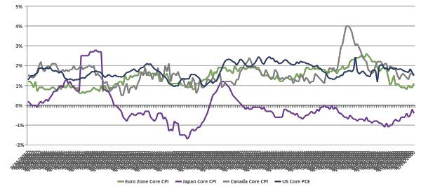
New Global Inflation Regime
Since 2009 many developed nations have experienced tepid inflation bounded between 1% and 2%
We believe increased globalization and innovation within developed nations has resulted in a new low inflation regime
Developed Nation Core Inflation Rates
12-month % change

Slide 8
Wage Growth

Slide 9
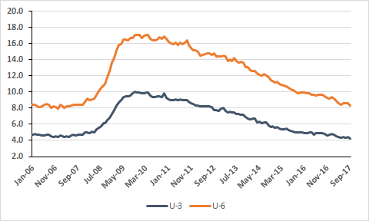
Unemployment
Civilian unemployment rate or U-3 has fallen to a post recession low of 4.2% while the U-6 measure of unemployment has also fallen to a low of 8.3%.
The spread between the two measures has fallen from a high of 7.4% in 2011 to the current spread of 4.1%, signaling a significant reduction in marginally attached workers plus part time workers.

Slide 10
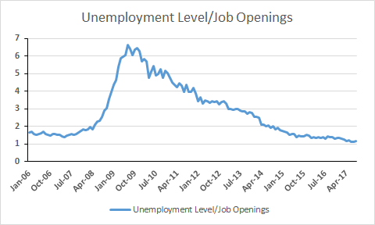
Total Unemployed per Job Openings
The Unemployment level per job openings is now at 1.17 meaning that not only has unemployment fallen, but also job openings have increased to approximately 6 million job openings.
This a strong sign for the economy as companies are looking to hire new workers even as unemployment levels are dropping.
Notes:
https://fred.stlouisfed.org/series/JTSJOL

Slide 11
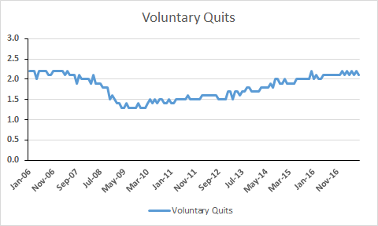
Voluntary Quits
Voluntary quits have also increased to a seasonally adjusted rate of 2.1 as workers feel more comfortable to leave their jobs in order to search for other opportunities.
This signals positive sentiment among workers in the workforce and their ability to find new jobs.
Notes:
quits rate can serve as a measure of workers’ willingness or ability to leave jobs.

Slide 12
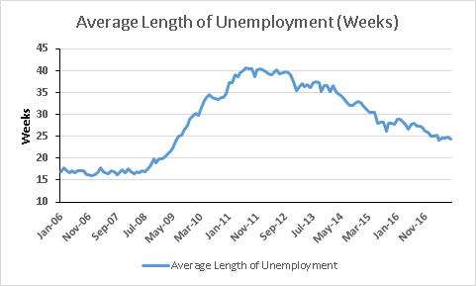
Average Length of Unemployment
The average length of unemployment was 26.8 weeks in September, a 2.4 week jump from the month before, potentially signaling a slowdown in hiring.
Although the length of unemployment has shortened since the recession, we still see that the length of unemployment significantly higher than pre-recession levels signaling a potential change in the labor markets as necessary skill levels for jobs are rapidly changing due to technology.

Slide 13
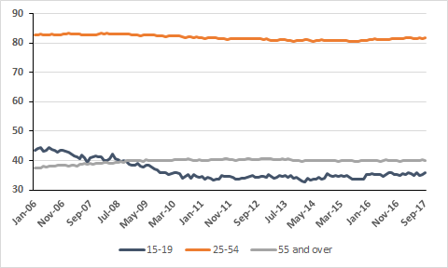
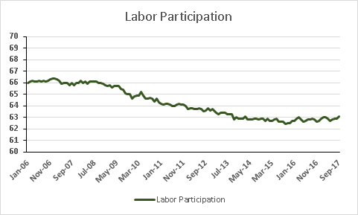
Labor Participation
With unemployment strongly recovering, the labor participation rate is still at a low level of 63.1%.
We believe that the labor participation rate may not recover very quickly as we see a collapse of teenager participation in the labor force to 35.8%. We believe this is due to a generational emphasis on education as teenagers are instead spending their summers preparing for standardized tests and college applications instead of looking for jobs.

Slide 14
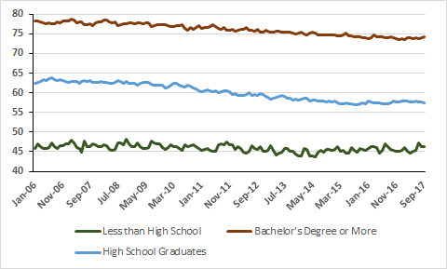
Labor Participation By Education
When broken down by education, there is a clear fall in labor participation by high school graduates, 25 and over, to 57.8% and a less extreme decrease among those with a bachelor’s degree or higher to approximately to 74.2% while those that did not graduate high school have stayed relatively constant.
This is a concerning sign as more highly educated workers are dropping out of the work force, possibly due to a change in skills demanded.
Notes:
THe recession

Slide 15
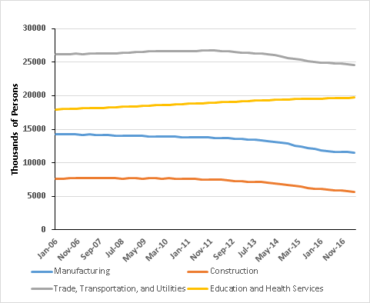
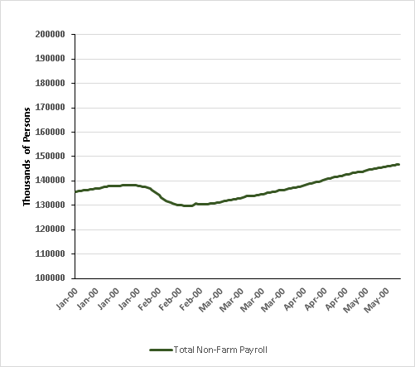
Non-Farm Payroll
As total non-farm payroll has increased to approximately 147 million people, we have seen most of recent gains being made by services such as in education and health services. This has helped offset the significant decreases that have occurred in the construction and manufacturing industries.
Notes:
https://fred.stlouisfed.org/release/tables?rid=50&eid=4881&snid=4900
https://www.bls.gov/news.release/empsit.t17.htm

Slide 16
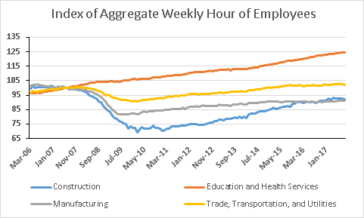
Manufacturing and Construction Employment
Measure of aggregate weekly hours worked by employees confirms the trend of the fall of manufacturing employees due to technological advancement and globalization. Construction work has also dropped drastically, although largely due to cyclicality of the industry as there appears to be a recovery occurring in that industry.
It also appears that education and health services has rapidly outpaced other major industries in the economy.
Notes:
https://www.washingtonpost.com/news/storyline/wp/2014/08/01/the-little-known-fred-charts-that-reveal-the-state-of-the-u-s-economy/?utm_term=.edd023aeb382

Slide 17
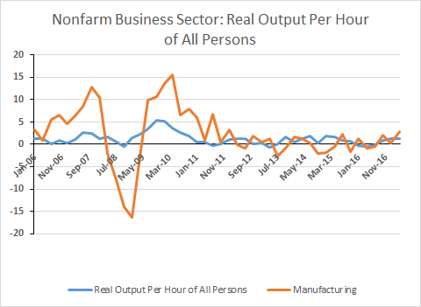
Real Output Per Hour of All Persons
Labor productivity has only increased slightly and steadily per quarter since the great recession.
Manufacturing has seen more volatility in productivity but appears to be stagnant in the past 5 years.
Notes:
Nonfarm seasonally adjusted

Slide 18
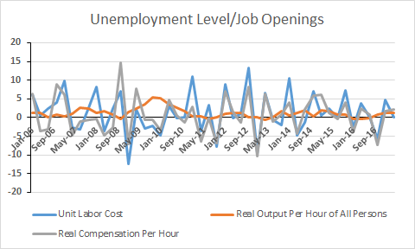
Labor Productivity & Wages
Labor productivity has increased by 1.3% earlier this year while unit labor costs have increased by .2% and real compensation per hour has increased by 2.1%.
We see this as a positive sign as it shows wage growth is occurring with a boost to labor productivity.
Notes:
https://fred.stlouisfed.org/series/PRS85006102
https://fred.stlouisfed.org/series/PRS84006111
https://fred.stlouisfed.org/series/PRS85006092
https://fredblog.stlouisfed.org/2014/11/measuring-labor-costs/?utm_source=series_page&utm_medium=related_content&utm_term=related_resources&utm_campaign=fredblog

Slide 19
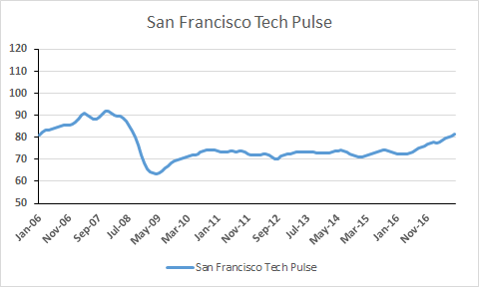
Health of Technology Sector
Technology has become a more important part of the U.S economy. The San Francisco Tech Pulse, which is commonly interpreted as the health of the tech sector based on employment and investment into IT goods, has increased to 82. This is a 10 point jump from two years ago showing increasing health and investment into technology.
Notes:
https://fred.stlouisfed.org/series/SFTPINDM114SFRBSF

Slide 20
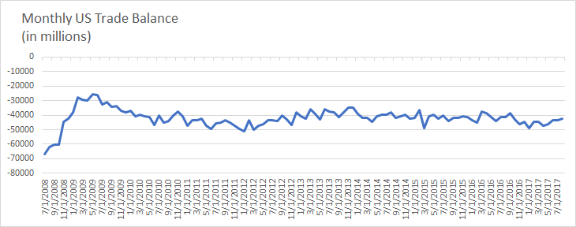
GDP: Trade Deficit
Trade Deficit-
Trade Deficit as percentage of GDP- average of -2.6% since 2009- continue to see this trend
Source: Federal Reserve Bank of St.Louis
Notes:
Trade Balance: Goods and Services, Balance of Payments Basis (BOPGSTB)

Slide 21
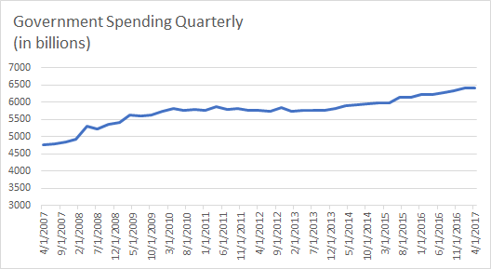
GDP: Government Spending
Source: Federal Reserve Bank of St.Louis

Slide 22
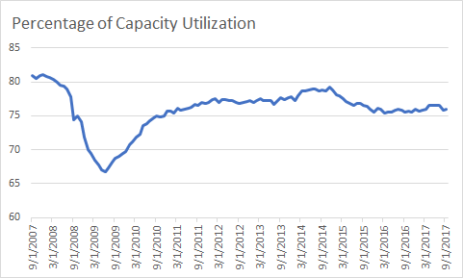
Capacity Utilization
Source: Federal Reserve Bank of St.Louis

Slide 23
GDP Gap
As an economy we are closing the GDP gap and approaching full output level.
You can see in the shaded regions that when Real GDP passed potential GDP there was a break in market cycle Ex: dot com bubble and the credit crisis
Source: Federal Reserve Bank of St.Louis

Slide 24
PCE Breakdown
The majority of PCE is made up of the services industry, close to 70% worth
Last months personal income and outlays report was healthy, reporting a $18 BB (.1%) increase in aggregate PCE, versus August numbers which were down $8.4 BB
**Side note, add another graph that shows the most recent years of PCE breakdown and maybe YOY growth
Source: Federal Reserve Bank of St.Louis

Slide 25
PCE Breakdown
Source: Federal Reserve Bank of St.Louis

Slide 26
Personal Income
Household incomes are rising, while the savings rate is falling
Savings rate falling is not necessarily a bad thing, consumers are more confident and consumer sentiment indexes are way up
Spikes in consumer savings and income in 2012 was because of a dividend/tax law which incentivized companies to issue higher dividend payouts before the legal change
Source: Federal Reserve Bank of St.Louis

Slide 27
PCE Breakdown
Consumers have be de-leveraging since the end of the financial crisis
There has been a slight uptick in leverage but nothing unhealthy
Source: Federal Reserve Bank of St.Louis

Slide 28
PCE Breakdown
Consumers have be de-leveraging since the end of the financial crisis
There has been a slight uptick in leverage but nothing unhealthy
Source: Federal Reserve Bank of St.Louis

Slide 29
There has been increases in demand for consumers, but a lack of supply in the market which has lead to higher home prices in the last several years
Source: Federal Reserve Bank of St.Louis

Slide 30
Inventory has been relatively flat
Source: Federal Reserve Bank of St.Louis

Slide 31
PCE Breakdown
Slight decline in retail sales
Source: Federal Reserve Bank of St.Louis

Slide 32
PCE Breakdown
Source: Federal Reserve Bank of St.Louis

Slide 33
Unwinding of the Balance Sheet

